Slide 1



MINI PROJECT PRESENTATION
TOPIC
Cycle Sustain Now
Bachelor of Technology
In
INFORMATION TECHNOLOGY
SESSION-2023-24
SUBMITTED TO -
Ms. Deepti SINGH
SUBMITTED BY –
Deepanshu Kumar (2102900130015)
Kanishka Varshney (2102900130024)
Pragya Dwivedi (2102900130031)
Tanu (2102900130044)

Slide 2
E-Waste Facility Locator
Institute Name:- ABES Institute Of Technology, Ghaziabad
Project ID:- 2023-MPJ-3IT-01
Team Name:- Cycle Sustain Now
Theme Name:- Smart Automation
Session:- 2023-24
Branch:- Information Technology (3rd Year)

Slide 3
INDEX
Problem Statement
What is E-Waste?
Current Challenges
Instance of Approach
Working of the project
Use Cases
Show Stoppers
Layouts
Technology Stack
References

Slide 4
PROBLEM STATEMENT
Website that tells you the location of the nearest e-waste collection and recycling facility. Offers educational pop-ups on the harmful components of your e-waste and their effects on the environment and human health if not disposed correctly. There could be an option to input the model of your old device and earn credit points relative to the amount of precious metals recovered from the device if disposed correctly.

Slide 5
What IS E-Waste?
Definition :
Example :
Definition :
E-waste is electronic products that are unwanted, not working, and nearing or at the end of their “useful life.” Computers, televisions, VCRs, stereos, copiers, and fax machines are everyday electronic products.
E-waste is any electrical or electronic equipment that’s been discarded.
Computers, televisions, VCRs, stereos, copiers, and fax machines are everyday electronic products.
The issue of e-waste is significant globally, even so, it is not as frequently mentioned. It causes the acceleration of climate change, results in the waste of significant resources, and endangers both the environment’s and humans’ health.

Slide 6
Current Challenges
The Prominent Challenges Of E-Waste Management In India :-
1. Poor infrastructure to recycle e-waste : Sadly, India has very few recognized and government-approved recycling centres to dismantle and repurpose electronic waste. Even, organized supply chains are very few in number.
2. A serious lack of awareness : Most consumers have little or no knowledge of the consequences of reckless e-waste disposal.
3. Mismanagement of products : In the present times, sourcing e-waste is challenging. There is a lack of knowledge about cost-effective and efficient e-waste management techniques, as well as how to maximize the utility of end-of-life products.
4. Unsustainable and ecologically degrading practices : Despite the urgency of formal and responsible dismantling of electronic waste, the actual waste processed is significantly lower. The ignorant mass continues to dispose of electronic waste in the most unfavourable conditions.

Slide 7
Provides mapping facility by connecting our database through integration with Google Maps API to provide relevant and appropriate e-waste center.
Provides educational pop-up relative to the precious metals removed from the device by creating an AI chat-bot.
Also provide recycling status by using AI.
If user perform disposing process at the center, they will earn credit points.
User can also play quizzes regarding e-waste to earn more credit points.
The user can redeem credit point during the recycling process to gain some extra profit.
INSTANCE OF APPROACH

Slide 8
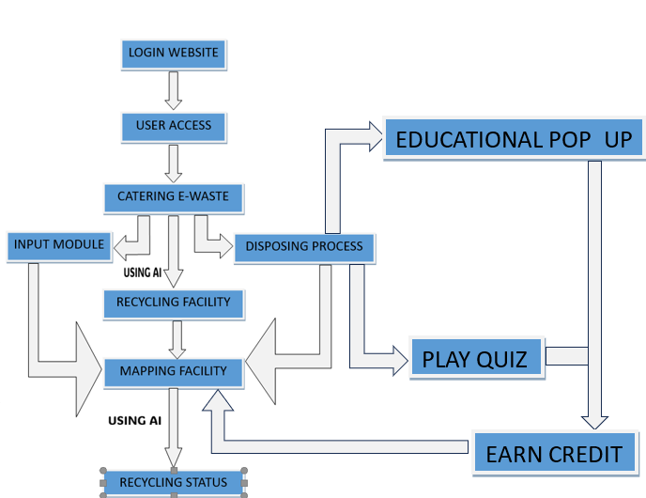
WORKING OF THE PROJECT

Slide 9
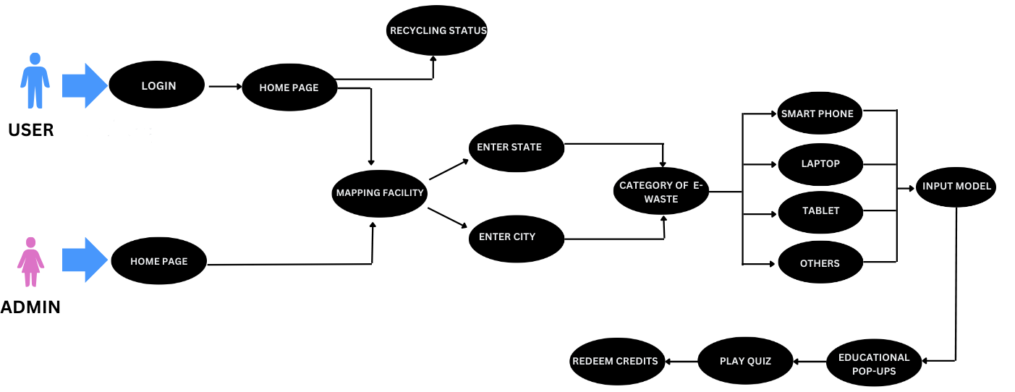
USE CASES

Slide 10
SHOW - STOPPERS
API
INTEGRATION
GOOGLE
MAPS
CHATBOT
RECYCLINGSTATUS
(AI)

Slide 11






TECHNOLOGY STACK

Slide 12
REFERENCES
https://www.irjmets.com/uploadedfiles/paper/issue_7_july_2023/42873/final/fin_irjmets1688561658.pdf
https://www.sciencedirect.com/science/article/pii/S294975072300024X
https://environment.rajasthan.gov.in/content/dam/environment/RPCB/WorldEnvironmentDay2023/Problem%20Statement%20for%20Electronic%20Waste.pdf

Slide 13

This Photo by Unknown Author is licensed under CC BY-ND

